Slide 1
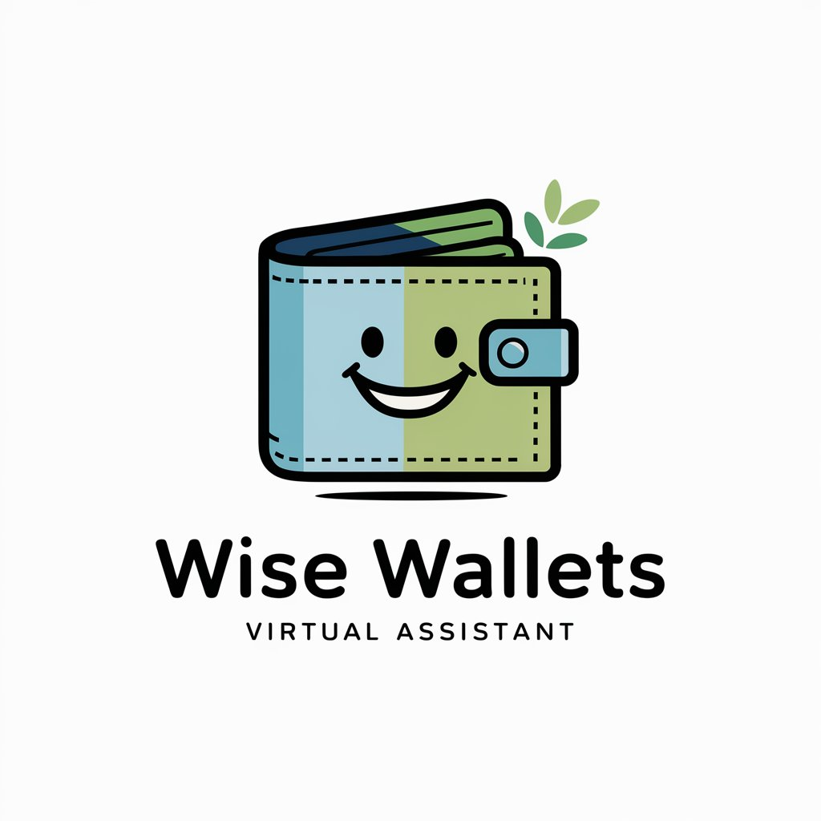
DAILY EXPENSE TRACKER WITH BUDGET ALERTS FOR iOS
T.Lavanya
192224039
AI&DS

Slide 2
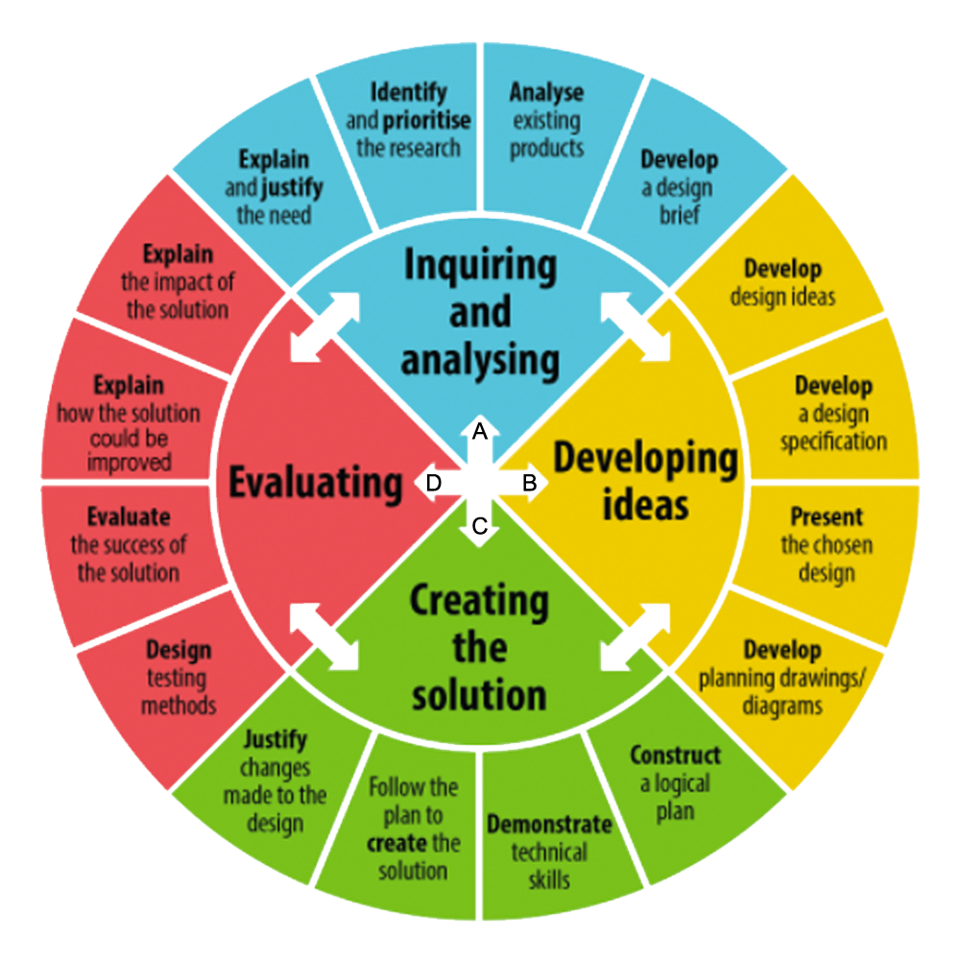
Product
Design
Cycle

Slide 3
PROJECT OVERVIEW
PROBLEM:
Many people struggle to track daily expenses and stay within budget. Without timely alerts or a simple way to monitor spending, they often overspend, leading to financial stress. Existing tools can be complex or lack real-time notifications, especially on iOS. There's a need for an easy, intuitive app to track expenses and send budget alerts.
SOLUTION:
Develop a user-friendly iOS app that allows users to effortlessly log daily expenses, categorize spending, and set custom budgets (daily, weekly, or monthly). The app will send real-time alerts when users approach or exceed their set limits, helping them make informed decisions and avoid overspending. It will also provide clear visual summaries and spending trends to support better financial planning and goal setting

Slide 4
PRODUCT DOMAIN STUDY
With rising living costs and increasing digital spending, managing personal finances is more important than ever. There’s a growing demand for a simple, effective iOS app that helps users track daily expenses, set budgets, and receive alerts—empowering them to stay in control of their money and build better financial habits.The app caters to students, working professionals, and families who need an intuitive tool to monitor their spending. It also promotes financial discipline by offering insights into spending patterns and encouraging smarter choices.
LinkedIn Article:
https://www.linkedin.com/pulse/how-build-personal-finance-app-from-scratch-2025-shivtechnolabs-dnptf

Slide 5

PROBLEM STATEMENT : USER NEEDS
Daily Expense Logging
Budget Setting and Management
Real-Time Budget Alerts
Spending Categorization
Visual Expense Summaries
Goal-Based Financial Tracking

Slide 6

PROJECT OVERVIEW
MY ROLE:
Product Planning, User Research, UI/UX Design, iOS App Development, Budget & Expense Logic Implementation, Testing & Debugging, Deployment & Maintenance, User Feedback & Iteration
MY RESPONSIBILITIES:
To design, develop, and maintain a secure, intuitive, and efficient iOS application that enables users to easily track daily expenses, set and manage budgets, receive timely alerts, categorize spending, and visualize their financial habits—helping users stay on top of their finances and make informed money decisions.

Slide 7
PROJECT TIMELINE
TASK | DESCRIPTION | START DATE | END DATE | DURATION
CONCEPT DEVELOPMENT | Define the app's purpose, target audience, and features.
RESEARCH & DEVELOPMENT | Study user needs, industry-specific requirements, and technologies to build a practical, scalable solution.
TESTING & VALIDATION | Conduct usability tests to refine features, ensure accuracy in feedback, and validate.
PRODUCTION & LAUNCH | Deploy the app and make it accessible to users.
POST-LAUNCH EVALUATION | Collect user feedback, monitor performance, and implement updates.

Slide 8

USER PERSONA 1
Name: Raheem
Age: 20
Occupation: Student
Income: 20,000
Lifestyle: Social, budget-conscious, busy balancing work and personal finances, prefers using apps to stay organized and save money effortlessly
PROBLEM:
While he values staying financially responsible, his busy lifestyle makes it hard to consistently track daily expenses and monitor his budget.
He struggles to categorize spending properly, leading to overspending in some areas without realizing it.
Frequently misses budget limits because he doesn’t get timely alerts, resulting in financial stress and difficulty saving money.
GOALS:
Ensure daily expenses are tracked effortlessly with automatic categorization and easy logging.
Provide real-time budget alerts to help users stay within their spending limits.
Offer clear visual summaries and spending insights for better financial awareness.
Help users set and achieve savings goals by monitoring progress and suggesting adjustments.

Slide 9

USER PERSONA 2
Name: Srinivasa Reddy Age: 55 Occupation: Finance Income:2,00,000 Tech Proficiency: High Lifestyle: Independent, Focused,Business Man
PROBLEM:
Srinivasa Reddy is a 55-year-old finance manager balancing a demanding career and family responsibilities. He lives alone in a suburban apartment.
With a busy work schedule and frequent business travels, he finds it challenging to keep track of his daily expenses and manage his monthly budget effectively.
Although he understands finance well, he struggles to monitor everyday spending habits in real time and often misses subtle budget oversights.
He wants an easy way to stay organized, avoid overspending, and ensure timely bill payments without spending too much time on manual tracking.
GOALS:
Stay organized and ensure all bills and expenses are tracked and paid on time to avoid late fees.
Monitor daily spending to prevent overspending and maintain financial discipline.
Easily review spending patterns to make informed budgeting decisions.
Save time on manual expense tracking with automated logging and alerts.
4.1-mini

Slide 10
USER JOURNEY MAP
PHASE | AWARENESS | CONSIDERING | ONBOARDING | USAGE | RETENTION
GOAL | Discover an app | Evaluates | Setup & Customize | Manage app | Continuation
SCENARIO | Forgetting Rent Deadlines,Disorganized Cleaning Schedules | Finds the Chomies app and explore its features | Downloads the app and begins setting up | Actively using the app to manage expense | Happy with the app and continues to use it regularly
TOUGHPOINTS | Spending,Savings | Review Ratings | Admin login | Reminders | Notifications
EMOTIONS | Frustration | Curious | Excited | Satisfaction | Motivated
ACTIONS | Comparing diff apps based on features | Downloads the app and app walkthrough | Setting up daily reminders,budget goals | Checking and updating the budget goals | Giving feedback or requesting new features
PAIN POINTS | Worried about app complexity | Uncertainty about the app | Complexity of initial setup | Possible confusion | Failure to update the tasks

Slide 11
COMPETITIVE ANALYSIS
COMPETITOR | FEATURE SET | USER EXPERIENCE | PRICE | STRENGTHS | WEAKNESSES
MINT | Expense Tracking | Easy to use | Free | Simple to Use it | Lacks in Categorizations
YNAB | Budgeting and Goal Setting | Moderate | Free/$ | Helps to set budget goals | Limited in Statistics
POCKETGUARD | Payments,Alerts | User-friendly | Free | Helps in Alerts for spending | Lacks in summary
GOODBUDGET | Payment tracking | Easy | Free | Popular for money transfers | Doesn't handle rent scheduling
WALLY | Alerts and syncing | Flexible | Free/$ | Great for Syncing the data | Not tailored Budget Goals

Slide 12

BUSINESS POTENTIAL
TARGET AUDIENCE • Primary: Budget-conscious individuals, including students, young professionals, and solo urban dwellers using iPhones. • Secondary: Busy professionals, freelancers, and small families looking for simple, mobile-first financial tracking tools.
GAP ANALYSIS • Most existing apps are overly complex or offer limited free features, creating barriers for casual users.Lack of real-time, customizable budget alerts tailored to individual spending behavior.Few iOS-native apps offer a seamless, intuitive user experience with both manual and automated tracking..
MARKET SIZE • iOS users actively seeking personal finance tools: Over 200 million globally.
• Budget-conscious users in Gen Z and Millennials: Approx. 80–100 million globally
.• Global personal finance app market: Expected to reach $1.6 billion by 2026, growing at 5.7% CAGR.

Slide 13
USER PAIN POINTS
Inconsistent Expense Tracking
Lack of Real-Time Budget Alerts
Overcomplicated Interfaces
Difficulty Understanding Spending Habits
No Personalized Budget Recommendations
Limited Free Features in Existing Apps
Lack of Visual Spending Insights
No Admin reviewing.

Slide 14
IDEATION ALTERNATIVES
Budget Alerts:
Alternative 1: Static monthly alerts when nearing limits.
Alternative 2: Dynamic, real-time notifications based on spending patterns and daily limits.
Chosen: Dynamic alerts for timely insights and greater user engagement.
Spending insights:
Alternative 1: Text-based summaries and charts at month-end.
Alternative 2: Visual dashboards with real-time updates and customizable filters.
Chosen: Visual dashboards for better clarity and faster decision-making.

Slide 15
ITERATIONS AND LEARNINGS
Budget Alerts:
First Iteration:Basic monthly alerts triggered only at the end of the month.
Learning: Users needed timely feedback. Implemented real-time alerts when approaching category limits and daily overspending.
Spending Insights:
First Iteration: Displayed only monthly summaries in graphs.
Learning: Users wanted clarity and engagement. Switched to interactive visual dashboards with pie charts, trends, and category breakdowns.
Category Management:
First Iteration: Only fixed categories were available.
Learning: Users had diverse spending habits. Introduced custom category creation and editing for better personalization.

Slide 16
USABILITY STUDIES
Expense Input
Issue: Users found adding expenses time-consuming.
Solution: Introduced quick-add options and auto-fill for frequent expenses to speed up the process.
Budget Alerts
Issue:Alerts were too generic and often ignored.
Solution: Made alerts more personalized and actionable based on spending behavior and category thresholds.
Spending Overview:
Issue: Users had difficulty understanding where their money was going.
Solution: Added clear visual summaries with daily, weekly, and monthly breakdowns.

Slide 17
USABILITY STUDIES
Expense Input
Success: Quick-add and smart suggestions made logging expenses faster.
Next Steps: Introduce voice input and OCR for scanning receipts.
Budget Alerts
Success: Personalized, real-time alerts helped users stay within limits
Next Steps: Allow users to set custom alert thresholds and quiet hours.
Spending Overview
Success: Visual dashboards improved user understanding of spending habits.
Next Steps: Add trend comparisons and savings goal progress tracking.

Slide 18
PRODUCT DESIGN MOCKUP
PROJECT IMPACT:
Enhanced Financial Awareness:Real-time tracking and alerts help users stay conscious of their spending and avoid budget overruns.
Improved Efficiency:Simplifies daily expense logging and budget monitoring, saving time and effort.
Convenience:Centralizes financial management with intuitive dashboards and customizable categories.
Stress Reduction:Automatic alerts and visual summaries reduce financial anxiety and support smarter decision-making.
WHAT I LEARNED:
User-Centered Design:Focused on creating features that align with users' financial habits and daily routines.
Simplicity and Clarity:Clean, intuitive interface ensures easy navigation and quick expense logging.
Iterative Process:Regular updates based on user feedback to continuously enhance functionality.
Focused Functionality:Streamlined tools for expense tracking, budgeting, and insights—all in one app.
Testing and Feedback Integration:User testing and data-driven insights guide improvements for a seamless experience.

Slide 19
PATENT
Unique Features:
Auto-Categorization of Expenses: Uses AI/ML to recognize and categorize expenses instantly without manual tagging.
Smart Budget Analysis: Predicts overspending and recommends adjustments.
Spending Pattern Analysis: Offers real-time daily and weekly visual insights.
Reminders and Notifications: Alerts for unusual spending or near budget limits.

Slide 20
NEXT STEPS
Step A: Finalizing Product Design and Features
Define and finalize core features including daily expense input, budget creation, real-time alerts, spending insights, and custom categories. Confirm the tech stack (Swift, Core Data)
Step B: Development and Iteration
Begin coding the iOS front-end interface and back-end data management systems.
Implement features for expense logging, budget calculations, real-time alert notifications, and spending categorization securely and efficiently.
Integrate third-party APIs for push notifications, data syncing, and optional payment or banking services.
Step C: Usability Testing and Refinements
Conduct extensive usability testing with a diverse group of users to uncover any usability issues or pain points.
Fix bugs, improve UI/UX elements, and optimize app performance based on test results.
Gather detailed feedback on features, responsiveness, and overall user satisfaction to guide final improvements.

Slide 21
ISO CODES
ISO 9001: Quality Management Systems: Ensure the app follows ISO 9001 standards for software quality, focusing on delivering a consistent, high-quality product.
ISO 27001: Information Security: Implement ISO 27001-compliant practices to ensure the secure handling of users’ personal data and payment information.
IEEE 29119: Defines best practices for thorough and effective software testing.
WCAG 2.1: Guides accessibility features to support users with disabilities.
WCAG 2.0: Ensures inclusive design for equal access by all users, including those with disabilities.

Slide 22



CONNECT
LET’S CONNECT:
Email:lavanyat4039.sse@saveetha.com
LinkedIn:linkedin.com/in/tatiparthi-lavanya

